Slide 1

Values, Beliefs, Attitude and Character “Form the basis of how we see ourselves as individuals, how we see others, and how we interpret the world in general.”
Sanjeeva Perera
Senior Academic Fellow - Faculty of Computing

Slide 2
Agenda
Values
Beliefs
Attitudes
Character

Slide 3
Values: What are they?
The principles that help you to decide what is right and wrong, and how to act in various situations – Oxford Dictionary
The importance of a value system is that once internalized it becomes, consciously or subconsciously, a standard or criterion for guiding one’s action.

Slide 4
List of Values:
Integrity: Acting in accordance with strong moral and ethical principles. It involves being honest, reliable, and consistent in one's actions and words.
Kindness: Showing consideration and concern for others, being friendly, generous, and compassionate.
Honesty: Being truthful and sincere in one's words and actions, free from deceit and fraud.
Financial Security: Ensuring stability and protection of one's financial resources, having enough savings and income to maintain a comfortable standard of living.
Freedom: Having the power to act, speak, or think as one wants without restraint or hindrance.

Slide 5
List of Values:
Family: Valuing the relationships and connections with one's immediate and extended family members.
Friends: Valuing the relationships and connections with one's friends and social network.
Love: Prioritizing emotional attachment, affection, and care towards others, including romantic partners, family, and friends.
Justice: Believing in fairness, fair treatment, and equal rights for all individuals.t
Empathy: Understanding and sharing the feelings of others, being able to put oneself in someone else's shoes.

Slide 6
List of Values:
Learning: Valuing knowledge, personal growth, and self-improvement, constantly seeking opportunities to learn and develop new skills.
Creativity: Valuing innovation, originality, and imagination in one's work and life.
Loyalty: Being devoted and faithful to one's commitments, responsibilities, and relationships.
Courage: Being brave, bold, and fearless in the face of adversity, taking risks, and standing up for what one believes in.
Happiness: Prioritizing positive emotions, joy, and well-being in one's life.

Slide 7
List of Values:
Health: Valuing physical, mental, and emotional well-being, taking care of one's body and mind.
Spirituality: Believing in a higher power or a transcendent reality, having a sense of purpose and meaning in life.
Responsibility: Taking ownership and accountability for one's actions, decisions, and consequences.
Respect: Recognizing and valuing the worth and dignity of all individuals, treating others with kindness and politeness.
Generosity: Being willing and able to give and share one's time, resources, and talents with others.

Slide 8
List of Values:
Gratitude: Appreciating and expressing thanks for the good things in one's life, being thankful for the people, experiences, and opportunities.
Patience: Being able to tolerate delay, trouble, or suffering without getting angry or upset.
Humility: Being modest, respectful, and unassuming in one's self-image and abilities.
Ambition: Having a strong desire and determination to achieve success, to be the best in one's field or area of expertise.
Adventure: Seeking out new, exciting, and challenging experiences, being open to taking risks and exploring new territories.

Slide 9
List of Values:
Personal Development
Values are integral to personality, personal development encompasses the ongoing process of self-improvement and self-awareness, guided by those values

Slide 10
Foundation, Focus, and Future values
Foundation values:
The values we need in place to have a solid foundation to our lives
If our foundation values are threatened or if we are stressed, satisfying these values will demand most of our energy, pulling us away from our focus and future values.
Who are habitually very stressed may live out much of their lives in this area.

Slide 11
Foundation, Focus, and Future values
Here are some foundational values that resonate across humanity:
Integrity: Upholding honesty, transparency, and moral principles even when faced with challenges.
Compassion: Demonstrating empathy, kindness, and concern for others’ well-being.
Respect: Treating everyone with dignity, regardless of differences in background, beliefs, or status.
Justice: Advocating for fairness, equality, and the protection of rights.
Courage: Facing adversity, taking risks, and standing up for what is right.
Wisdom: Seeking knowledge, learning from experiences, and making informed choices.
Gratitude: Appreciating life’s blessings and expressing thankfulness.

Slide 12
Foundation, Focus, and Future values
Focus values:
These are those value priorities in our lives that describe,
our present world view,
our criteria for decision making,
our attitude toward relationships, and
the focus of most of our energy.
We therefore tend to be more aware of our focus values than we are of our foundation or future values.
Focus values can evolve over time based on our life circumstances, experiences, and personal growth

Slide 13
Foundation, Focus, and Future values
Here are some examples of focus values:
Health and Well-Being: Prioritizing physical and mental health, self-care, and overall well-being.
Family and Relationships: Nurturing meaningful connections with loved ones, fostering trust, and investing time in relationships.
Personal Growth: Continuously learning, developing skills, and expanding our knowledge.
Work Ethic and Excellence: Striving for excellence, being diligent, and maintaining a strong work ethic.
Creativity and Innovation: Encouraging originality, thinking outside the box, and embracing creativity.
Financial Responsibility: Managing finances wisely, saving, and making informed financial decisions.
Environmental Stewardship: Taking care of the planet, reducing our ecological footprint, and promoting sustainability.

Slide 14
Foundation, Focus, and Future values
Future values:
These represent what is important to us about the future we are moving into.
Because they are not yet fully developed, but at the same time are important to us, they motivate us to grow and develop – pulling us into the future every moment of our lives.
Our future values evolve as we learn, grow, and adapt. They serve as a compass, guiding us toward the life we envision for ourselves.

Slide 15
Foundation, Focus, and Future values
Here are some examples of future values:
Purpose and Meaning: Seeking a life that feels purposeful and meaningful, whether through career, relationships, or personal pursuits.
Legacy: Considering the impact we want to leave behind—how we’ll be remembered by future generations.
Adventure and Exploration: Desiring new experiences, travel, and pushing boundaries.
Financial Independence: Striving for financial stability and freedom.
Learning and Innovation: Embracing lifelong learning, curiosity, and adaptability.
Healthspan: Focusing on quality of life as we age, rather than just lifespan.
Social Impact: Contributing positively to society, whether through activism, volunteering, or philanthropy.

Slide 16
Value of values
! When we practice, actualize or embody our priority values, we experience our lives as meaningful, significant and important.
! Values help us understand why we believe what we believe – and, if we wish, to change it.
! Shared values are the basis of relationship – the better we understand our own and others’ values, the more likely we are to have meaningful and fulfilling relationships.
! If we value something, we will go after it – we will be motivated by it. Thus, if we
understand our values, we also know what motivates us.
! Knowing our own values makes us more tolerant of others’ values – and of them as people – and so leads us to appreciate diversity.

Slide 17
Value of values
! Being aware of our values helps us answer some of the big coaching questions such as ‘Who am I?’ and ‘What is the difference I want to make?’
! Discerning our future values enables us to act more intentionally and move smoothly into future phases of our lives.
! Knowing our foundation values helps us deal better with difficulty and stress and return to equilibrium more quickly.
! Teams that are unaware of their value priorities will tend to operate at the lowest common denominator world view; self aware teams can operate at the highest common denominator

Slide 18
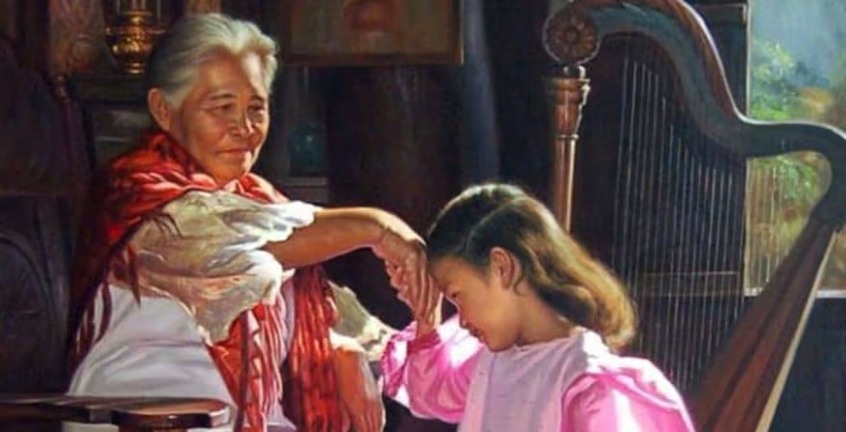
Value Test “This test is designed to help individuals discover their core values through a series of simple but developing exercises.”
Sanjeeva Perera
Senior Academic Fellow - Faculty of Computing

Slide 19
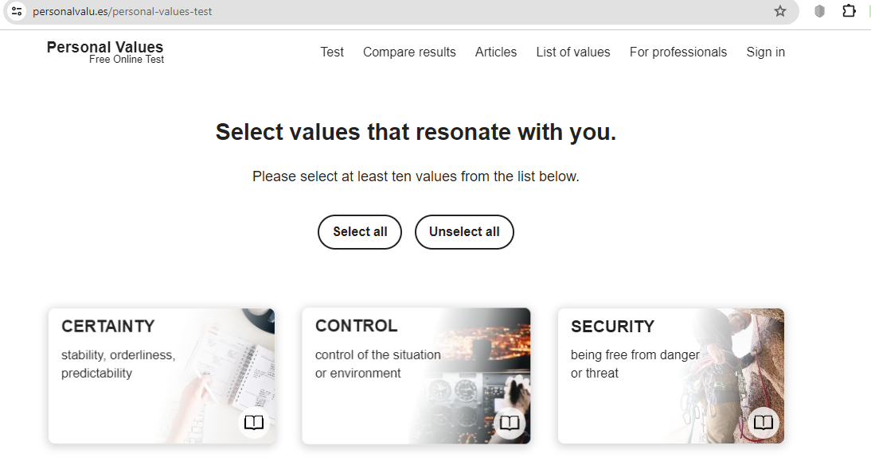
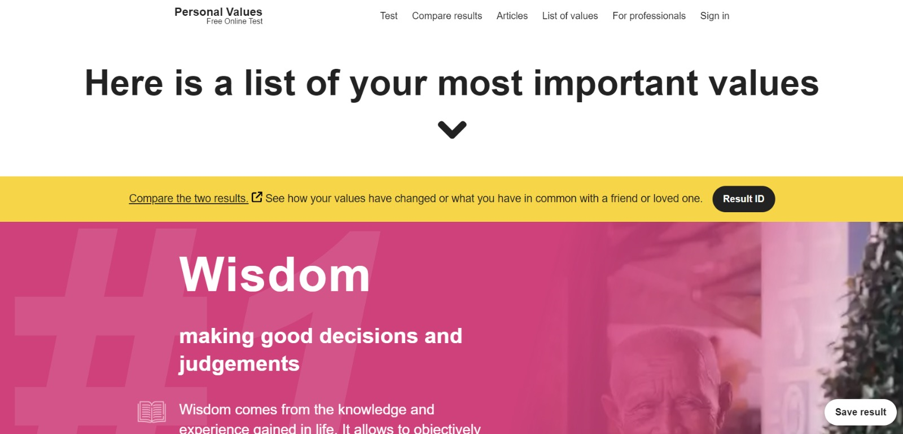
Value Test
https://personalvalu.es.
One popular personal "Value" test is offered by the website https://personalvalu.es. This test is designed to help individuals discover their core values through a series of simple but developing exercises. The website explains that values are things that are especially important to us and can be described as goals that we want to achieve in the long term. They can shape us as a human being and determine how we are perceived by others. The test results can help individuals make decisions that are in line with their personal values, serving as a compass for them to follow in moments of doubt.
Value test
Click https://personalvalu.es.
Please select at least ten values from the list below.
Once completed you get list of your most important values.
Notes:
It is also useful to be aware of possible liabilities/weaknesses associated with each style. Be aware of these tendencies both in yourself and in those you manage.

Slide 20

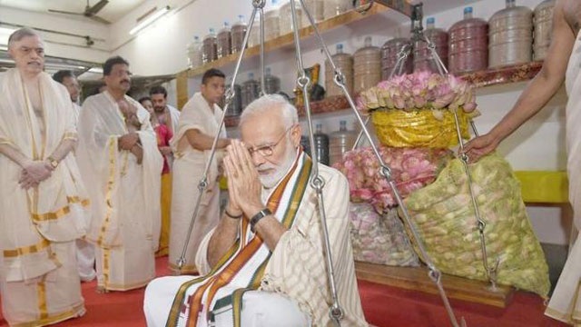
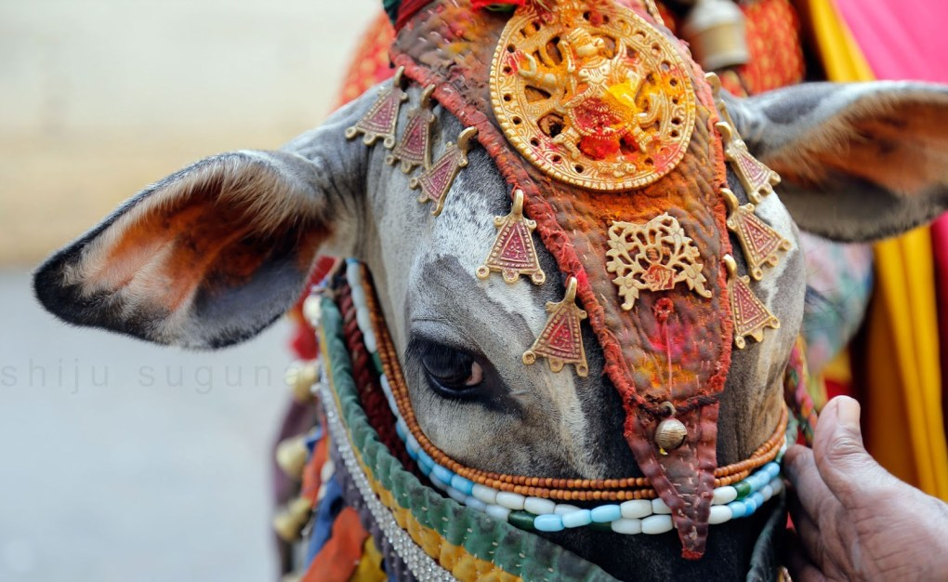
Beliefs

Slide 21
Beliefs
“Beliefs are constructs that we hold to be true, especially one without proof”
“Belief is the state of mind in which a person thinks something to be the case with or without there being empirical evidence to prove that something is the case with factual certainty”
-Wikipedia

Slide 22
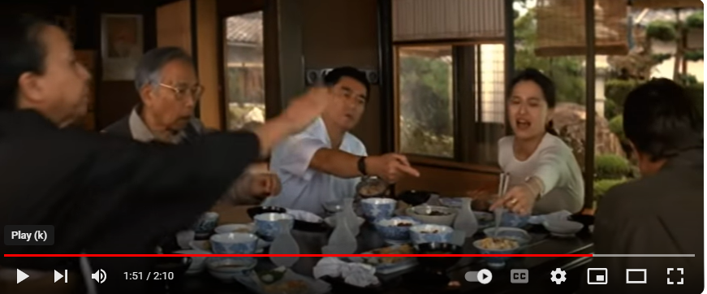
Beliefs
Video - Asian and Western Dinner Etiquette – Differences
Jack is having a meal with his Japanese girlfriend. What problems is he having? And how many mistakes does he make?
Customs: common or established practices.
Manners: behaviour regarded as appropriate in a particular society.

Slide 23
Attitude
Attitude is a mindset or a tendency to act in a particular way due to both an individual’s experience and temperament.
An attitude includes three components: an affect (a feeling), cognition (a thought or belief), and behavior (an action).
Although the feeling and belief components of attitudes are internal to a person, we can view a person’s attitude from his or her resulting behavior.

Slide 24
Attitude Model
genetics
Informational/
Cognitive
(i.e. beliefs)
Attitude
Behavior
socialization
Affective
(i.e. emotions)
Measurable in
the brain with fMRI
(functional Magnetic
Resonance Imaging)
observable
learning

Slide 25
Attitude
Attitudes may simply be an enduring evaluation of a person or object (e.g., “I like John best of my coworkers”), or
An emotional reactions to objects and to people (e.g., “I dislike bossy people” or “Jane makes me angry”).
Attitudes also provide us with internal cognitions or beliefs and thoughts about people and objects (e.g., “Jane should work harder” or “Sam does not like working in this department”).
Attitudes cause us to behave in a particular way toward an object or person (e.g., “I write clearly in patients’ charts because it upsets me when I can’t read someone else’s handwriting”).

Slide 26
Attitude
Positive Attitude | Negative Attitude
Individuals who have a positive attitude will pay attention to the good, rather than bad in people, situations, events, etc. | People with a negative attitude ignore the good and pay attention to the bad in people, situations, events, etc.
Positive attitudes are rewarded. It means the individual is encouraged to do the same thing in future. | Negative attitudes are punished in order to discourage the same action in future.
If we think positive thoughts we will surely experience such emotions as joy, love, gratitude, peace, and hope. | If we think negative thoughts we will definitely have negative feelings such as anger, disappointment, irritation, envy, etc.
Having a “positive attitude” means a person believes everything happens for the best in the end. | A person with a “negatives attitude” tends to believe their best days are in the past. There is nothing to “look forward to” and considers it a waste of time and energy.

Slide 27
Attitude
Positive Attitude | Negative Attitude
It is an optimistic approach of a person to achieve good results. | It is a pessimistic mindset of a person who is not capable of handling critical issues.
It can achieve long-term goals easily and in time | It can achieve some initial goals but not the long-term goals
It is a process of solving problems. | It is a process of looking for problems.
A person with a positive attitude pays attention to the virtues of others. | A person with a negative attitude pays attention to other people’s shortcomings.
These persons always see opportunities. | These persons see only limitations.

Slide 28
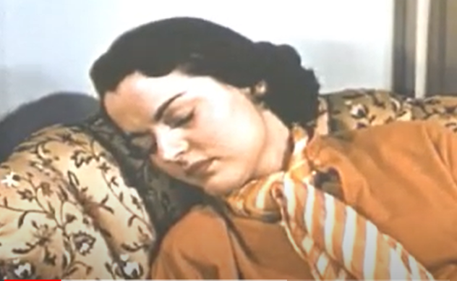
Watch the Video : To gain a deeper understanding of how self-reflection and seeing our own reflection can impact our attitudes
Having A Good Attitude & Being Courteous in the Office Part 1 (Video)
Having A Good Attitude & Being Courteous in the Office Part 2 (Video)

Slide 29
Character
Group of qualities that make a person, group or thing different from others.
What is “good character?” One definition is
1. “knowing the good, desiring the good and doing the good”; i.e., the head, the heart, the hand.
2. “understanding, caring about and acting on core ethical values such as honesty, responsibility, respect, hard work and caring for others.”

Slide 30
How Character develops
Your values shape your beliefs
Your beliefs shape your attitudes
Your attitudes shape your behaviors/actions.
Your behaviors/actions shape your habits
Your habits shape your character
Your character shapes your destiny

Slide 31
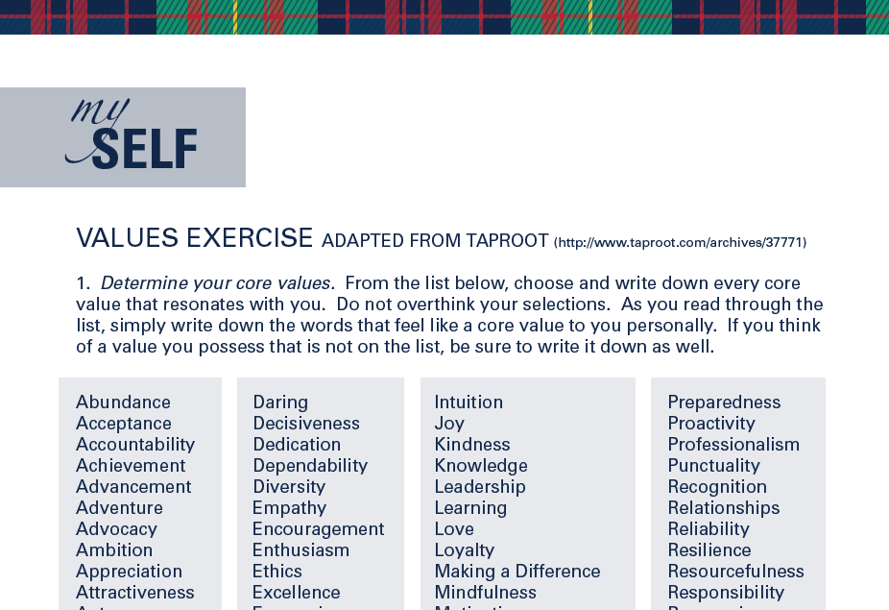
Values Exercise (attached to Course web)

Slide 32
Values exercise
STEP 1: Start with a Beginner’s Mind
STEP 2: Create Your List of Personal Values
STEP 3: Chunk Your Personal Values into Related Groups
STEP 4: Highlight the Central Theme of Each Value Group
STEP 5: Determine Your Top Personal Core Values
STEP 6: Give Your Personal Values Richer Context
STEP 7: Test the Ecology of Each Value

Slide 33
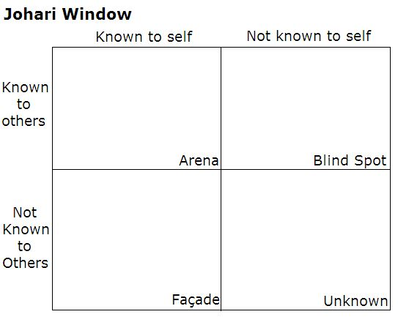
Johari window exercise
Johari Window: A graphic model of awareness in interpersonal relations
Developed by Joseph Luft (1916–2014) and Harrington Ingham (1916–1995) in 1955
Façade - mystery

Slide 34
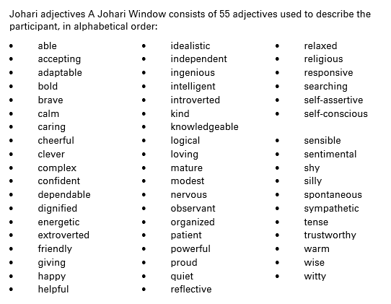
Johari Window

Slide 35
Concluding remarks
Knowing values, beliefs and attitudes helps us to develop a compelling character, to live a remarkable professional life
Industry always emphasize, “We hire individuals with good values and attitudes, because with those qualities, developing their technical skills is a simple task”
Know thyself – Socrates
Knowing yourself is the beginning of all wisdom – Aristotal

Slide 36
Exercise
- Write “About Me” paragraph to a CV highlighting your core values. This may contain 5-6 Sentences (60~75 words).
- Complete Johari window exercise by getting feedback from your parents, friends, teammates, teachers
- Write a reflective journal on an incident/situation in real life that you faced where content discussed in this lecture will be useful/can be put into practice

Slide 37
Questions ?

